Slide 1
6 June 2017
Sunsetting SixXS @ 2017-06-06
Jeroen Massar & Pim van Pelt, SixXS
jeroen@sixxs.net / pim@sixxs.net
jeroen@massar.ch / pim@ipng.nl
IPv6 Golden Networks
Image: Sunset in Tikehau, French Polynesia

Slide 2
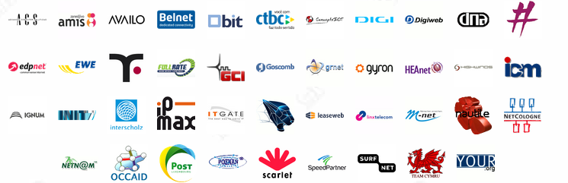
SixXS
SixXS is a small hobby project, grown a bit big, that provides a service for ISPs for a quick way of enabling their user base with IPv6.
Thanks to all the ISPs who have provided the PoPs, as without them it would not have been possible!

Slide 3


Just the two of us…
Jeroen Massar
  Day-to-day running, SixXS v1, v2+ design,
  sixxsd, frontend, PuTTY, ecmh, *
  Btw, my first IPv6 prefix was 5f04:4f00:c0xx::something courtesy of SURFnet (RFC1897).
  The remote tunnel endpoint used was zesbot.ipv6.surfnet.nl which is still alive today.
  Work: Massar Networking
Pim van Pelt
  Original IPng.nl project, SixXS v1 design,
  policy, more PoPs, whiskey!
  Work: Google

Slide 4
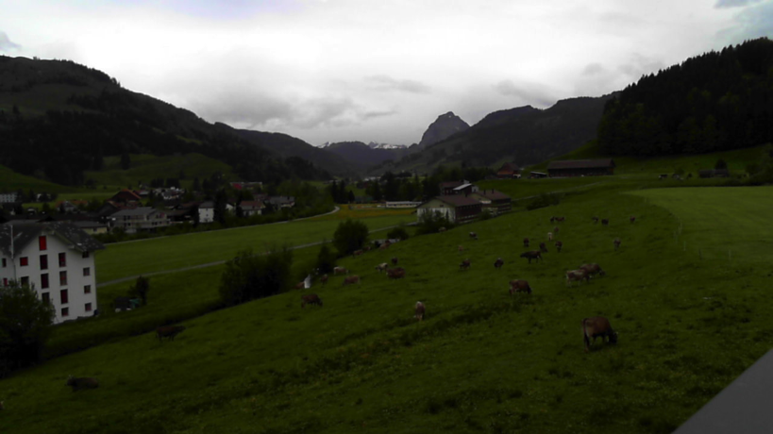
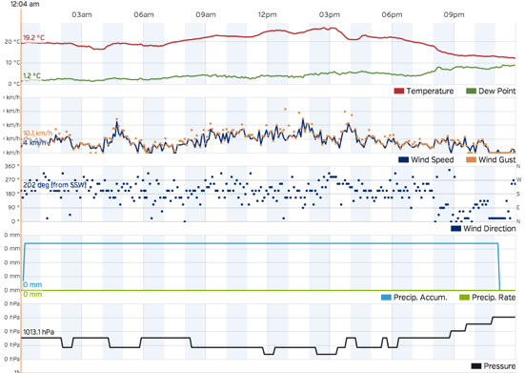
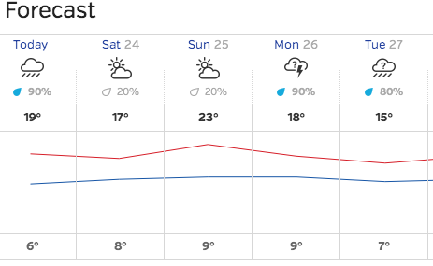
Why SixXS?
Didn’t have a static IPv4 address at home, didn’t have an IPv4 prefix either, everything behind NAT.
IPv6 gave access from other locations with (tunneled) IPv6 to home (which had a tunnel).
Can play IPv6Quake with friends without NAT issues.
Watch the cows on the home cam. (RPi with a USB webcam on IPv6)
Check the weather at home.

Slide 5
Short History (1/2)
2000: Started in as IPng.nl with 1 PoP in Amsterdam.
2002: Became SixXS as we provided the service for multiple ISPs, GRH launched.
2003: Heartbeat, TIC, IPv6Gate.
2004: AICCU, IPv4Gate.
2005: USA, GRH Distributed Traceroute.
2006: AYIYA support, 6bone shutdown.
2007: New Zealand, Wiki, BitTorrent Tracker.
2008: IPv6 DNS Glue, DNSSEC, 10k+ users
(continued on next page)
https://www.sixxs.net/news/

Slide 6
Short History (2/2)
2009: -SIXXS handles, NTP service, Google-over-IPv6
2010: Brazil!, per-tunnel TIC password
2011: Alaska, Czech Republic, Greece, Hungary, New Caledonia, Russia + sixxsd v4 beta
2012: sixxsd v4 everywhere, Vietnam, Live Tunnel Status, 10 years SixXS
2013: 35k active users, TIC STARTTLS, real SSL cert
2014: maybe finally new AICCU? ☺

Slide 7
RFC3053 – IPv6 Tunnel Broker
Tunnel Broker
config
PoP
IPv6 router
IPv4 router
server
you

Slide 8
Protocol 41
Protocol 41 = IPv6
It specifies how to put an IPv6 packet inside IPv4.
Protocol 41 is static only.
Protocol 41 doesn’t cross NATs.
https://www.sixxs.net/faq/connectivity/?faq=comparison

Slide 9
SixXS Tunnel Broker
Tunnel Broker
config
PoP
stats
IPv6 router
TIC
IPv4 router or NAT
server
you

Slide 10
Heartbeat
Dynamic/non-24/7 IPv4 endpoints.
Proto-41 is static. The moment the user unplugs, another user can get that IPv4 address. That user then gets proto-41 packets and the firewall tool beeps with warnings, which sometimes results in abuse reports because we are attacking them.
Allows one to move around proto-41 tunnels automatically or enable/disable them on the fly.

Slide 11
AYIYA – Anything in Anything
Proto-41 tunnels can’t cross NATs.
Proto-41 tunnels are not authenticated.
(read: one can spoof them easily)
Heartbeat runs next-to the proto-41 tunnel. Heartbeat might work, proto-41 might not.
AYIYA solves these issues by tunneling IPv6
inside IPv4/UDP and signing these packets.

Slide 12
AICCU
Automatic IPv6 Connectivity Client Utility
Proto-41, heartbeat and AYIYA tunnels.
Simple “Test” mode for diagnosing common issues, testing at least that the basics work (or not).
Windows, Linux, *BSD, OSX, AIX, Solaris, etc
Still in the pipeline:
Comprehensive “test” mode.
GUI/Web-interface for all platforms.

Slide 13
CPEs / Mobiles
AVM Fritz!Box has native heartbeat support.
Heartbeat support per TCL on Cisco.
Various vendors (Draytek, ZyXEL, Motorola, etc) include AICCU out-of-the-box with a little UI interface to configure it.
Most Linux-ish distributions have it (DD-WRT, Debians, Redhats etc)
Two Android apps: IPv6Droid + Androiccu.
(IOS VPN API is only available under NDA… hence no support there yet)
AYIYA is great for mobile devices (laptop/phone)

Slide 14
Abuse and ISK
We require proper details, as effectively we become the IPv6 ISP for the user.
We need these for abuse handling.
People are less inclined to do bad things when their details are known -> kept SixXS possible!
ISK is our Credit system, it keeps people interested in keeping their tunnel up, and it avoids people who are ‘bad’ from wasting resources.
We once accepted XING/LinkedIN for bonus credit allowing getting a /48 subnet, useful when using a router (eg Fritz!Box). We do not anymore as default subnets exist to solve that problem.

Slide 15
The SixXS Daemon
Linux/*BSD kernels not made for 2k+ interfaces (tunnels), both randomly lost routes and even tunnel interfaces or endpoints.
sixxsd has a single ‘tun’ interface, we route /40s into that (yup, 5x /40s on deham01 + dedus01 go into it ;)
Handles tunnel encap/decap for proto-41 & AYIYA.
Lookup of tunnels without tree: we know the IPv6 address and structure
Handles stats (traffic count, latency test etc)
Tunnel prefix + 0x8000 = default routed subnet
https://www.sixxs.net/faq/sixxs/?faq=sixxsd

Slide 16
Prefixes
Tunnel Prefix:
  2001:db8:1000:0abc::/64
  ::1 = PoP, ::2 = you
Default Routed Subnet Prefix:
  2001:db8:1000:8abc::/64
  Routed towards 2001:db8:1234:0abc::2
Full Subnet
  2001:db8:1234::/48
  Routed towards 2001:db8:1234:0abc::2

Slide 17
IPv6Gate
Allows access to any IPv4 website over
IPv6 from IPv6-only hosts:
http://www.nzz.ch.sixxs.org
Also allows the reverse: IPv6-only site
from IPv4-only host:
http://www.kame.net.ipv4.sixxs.org
HTTP only; no automatic clients/torrents allowed
More details https://www.sixxs.net/tools/gateway/

Slide 18
RFC4193 - ULA
IPv6 ULA (Unique Local Address)
RFC4193 Registration
fd00::/8 ULA Locally Assigned.
It is Unique, but maybe not Unique enough as it has a chance that it is not.
fc00::/8 ULA “Registered” – not specified
and thus can’t be used.
Nearly 200 registrations
Of course not guaranteed, when people don’t check this list it can’t be.
https://www.sixxs.net/tools/grh/ula/

Slide 19
GRH – Ghost Route Hunter
Peers actively with over 150 ISPs around the world.
A tool for detecting and hunting down Ghost Routes in the IPv6 routing tables and displaying DFP availability.
Distributed Looking Glass
Missing Prefixes
Prefix Comparison
https://www.sixxs.net/tools/grh/ula/

Slide 20
Userbase
38’393 7-day active users in 140 countries.
44’673 tunnels spanning 118 countries
12’632 /48 subnet delegations (28.28%)
  (every tunnel has a /64 per default)
Our peak 7DA usage was over 50’000 users
Full statistics, including distributions by country, can be found on the SixXS website

Slide 21
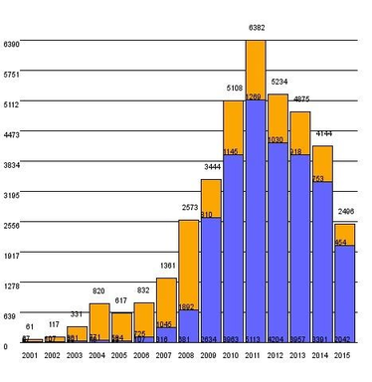
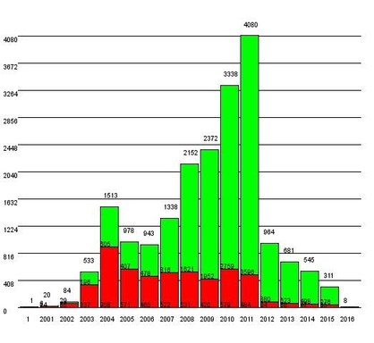
Usage
New users per year
New tunnels per year

Slide 22
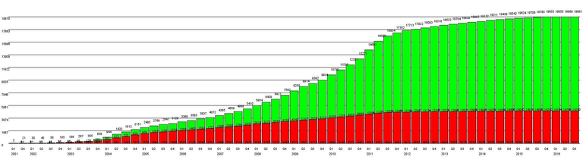
Cumulative Growth

Slide 23
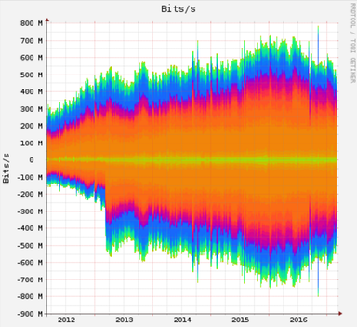
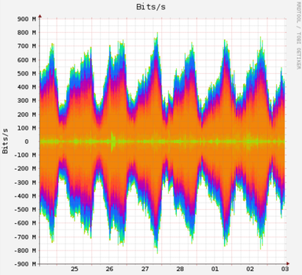
Traffic

Slide 24
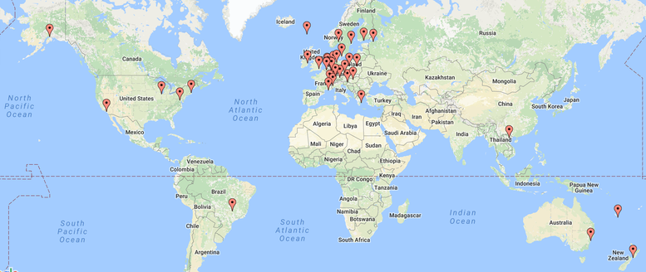
PoPs around the world
46 PoPs active in 2017, 65 different PoPs over lifespan of the project.
Address space totals a /33 of in-use IPv6 address space:
85x /40 or 21’760 /48's or 1x /34 + 1x /36 + 1x /38 + 1x /40

Slide 25
Accomplishments
PoPs on five major continents, missing Africa and Antarctica
sixxsd - software based router with high performance tunneling support
Heartbeat protocol (IANA port 3740) and IETF draft
AYIYA protocol (IANA port 5072) and IETF draft
Community outreach (example RIPE, IETF, ISOC, AMS-IX IPv6 Awareness Day)
Research done with GRH (Ghost Router Hunter) to:
Help eradicate global IPv6 routing issues (Ghost Routes)
IPv6 Bogon Route detection
Distributed Looking Glass and Traceroute
AICCU (Automatic IPv6 Connectivity Client Utility)
Automatic setup of IPv6 connectivity providing only username + password.
Awards of Excellence in the Implementation Award Category in the IPv6 Application Contest 2004
Jim Bound IPv6 Award from IPv6 Forum
Incorporated into commercial Draytek, ZyXel, Motorola CPE products
Heartbeat & TIC support out the box in AVM Fritz!Box
Very few outages over 18 years of operation
Pre-production access to Google and Wikipedia IPv6 servers through SixXS DNS recursors

Slide 26
Why Sunset? Chicken & Egg
Content providers claimed that investing in IPv6 rollout would be useless because there were not sufficient numbers of large ISPs which offered it.
Access providers claimed that investing in IPv6 would be useless because there were not sufficient numbers of large content providers which offered it.
Both content providers and access providers claimed their customers didn’t demand it and there was no business justification in doing so.

Slide 27
Why Sunset? Current State
Content providers, largely, have switched to IPv6. Examples: Wikipedia, Google, Youtube, Facebook, Akamai, Netflix, Microsoft, Yahoo.
Access providers are starting to move on IPv6 deployments: 18% of the Internet has IPv6 connectivity, roughly doubling year over year.
The access providers generally still claim that there is not sufficient customer demand to invest in IPv6.

Slide 28
Why Sunset? ISPs point to SixXS: use them!
Today, SixXS plays an insignificant role in converting the opinion on (1), (2) and (3) and is more recently (2016 and beyond) being quoted by several large access providers as a compelling alternative for their few customers who asked for IPv6, along the worrying lines of “SixXS offer tunnels, so we are not planning to provide native IPv6 at this time”.
A call to action in 2016, asking our users to call their ISP and ask about rollout plans, yielded some reasonable engagement from SixXS users (for which we are incredibly grateful), but arguably disappointing results from the ISPs, particularly the very large ones. Extensive data can be found on the SixXS wiki page.

Slide 29
Timeline for Sunset
2017-03-01: T-14wk Decision made by Jeroen and Pim to start the sunset project.
2017-03-06: T-13wk Communicate to PoP admins (e-mail, referencing intent and problem statement)
2017-03-13: T-12wk Communicate to PoP admins (e-mail, details (this doc))
2017-03-20: T-11wk Wrap up feedback from PoP admins, prepare publication to the users Initial backup of SixXS PoPs completed.
2017-03-23: T-10wk Publish to SixXS website. One-time mail to all users, noting the sunset date and pointing to rationale and FAQ.
2017-03-29: T-10wk Publish to IPv6 communities, social media, et al.
2017-04-17: T-7wk Due date for static SixXS website, FAQ, publication of rationale.
2017-05-29: T-1wk Convert info@sixxs.net to an autoresponder pointing at rationale+FAQ.
2017-06-06: (Tuesday) Turn off TIC and SixXSd on PoPs, retire IPv6Gate, shut down whois server.
2017-06-12: T+1wk: Secondary backup of SixXS PoPs completed.
2017-06-19: T+2wk: Power off SixXS PoPs, IPv6Gate, return resources
2017-06-26: T+3wk: Destroy PII data (mysql database).
2017-07-01: Close out the sunset project.

Slide 30
Questions?
Jeroen Massar & Pim van Pelt
http://www.sixxs.net/
jeroen@sixxs.net / pim@sixxs.net
jeroen@massar.ch / pim@ipng.nl

Slide 31
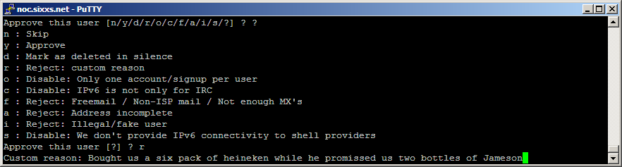
Reviewing
All requests are reviewed by humans (read: me).
As most faulty requests have similar things wrong we have a standard list of rejections, thus don’t be offended when you get rejected, it is not only you…
We reject in hope to receive clarification from the user why something looks odd.

